Slide 1

Information geometry: A short introduction with some recent advances
Frank Nielsen
Sony Computer Science Laboratories Inc
Tokyo, Japan

Slide 2
Talk outline
Information geometry from the pure viewpoint of geometry:
➔ Geometry of dual structures
Dual multivariate quasi-arithmetic averages:
➔ Information geometry yielding a generalization of quasi-arithmetic means
Chernoff information and its purely geometric counterpart:
➔ Geometry likelihood ratio exponential families
Duo Bregman pseudo-divergences:
➔ Application to KLD between truncated densities of an exponential family

Slide 3
Information geometry: A short introduction to the geometry of dual structures
Geometry defines the architecture of spaces

Slide 4
Information geometry (IG): Rationale and scope
IG field originally born by investigating geometric structures of statistical/probability models (e.g, space of Gaussians, space of multinomials)
Statistical models: parametric vs nonparametric models, regular vs singular (ML) models, hierarchical (ML) or simple models, ...
Define statistical invariance, use language of geometry (e.g., ball, projection, bisector) to design algorithms in statistics, information theory, statistical machine learning, etc.
IG study interplays of statistical/parameter divergences with geometric structures
Relationships between many types of dualities in IG: dual connections, reference duality (dual f-divergences), Legendre duality, duality of representations/monotone embeddings, etc

Slide 5
Geometric science of information (GSI)
Further extend broadly the original scope of information geometry by unravelling connections of information geometry (IG) with other domains of geometry like:
geometry of domains and cones (e.g., Siegel/Vinberg/Koszul)
geometric mechanics for dynamic models (symplectic/contact geometry)
thermodynamics/thermostatistics and deformed statistical models
geometric statistics (eg, computational anatomy/medical imaging)
shape space analysis and deformation (computer vision)
algebraic statistics (manifolds versus algebraic surfaces/varieties)
dynamics of learning (singularity, plateau)
neurogeometry (neuroscience)
etc.
franknielsen.github.io/GSI/

Slide 6

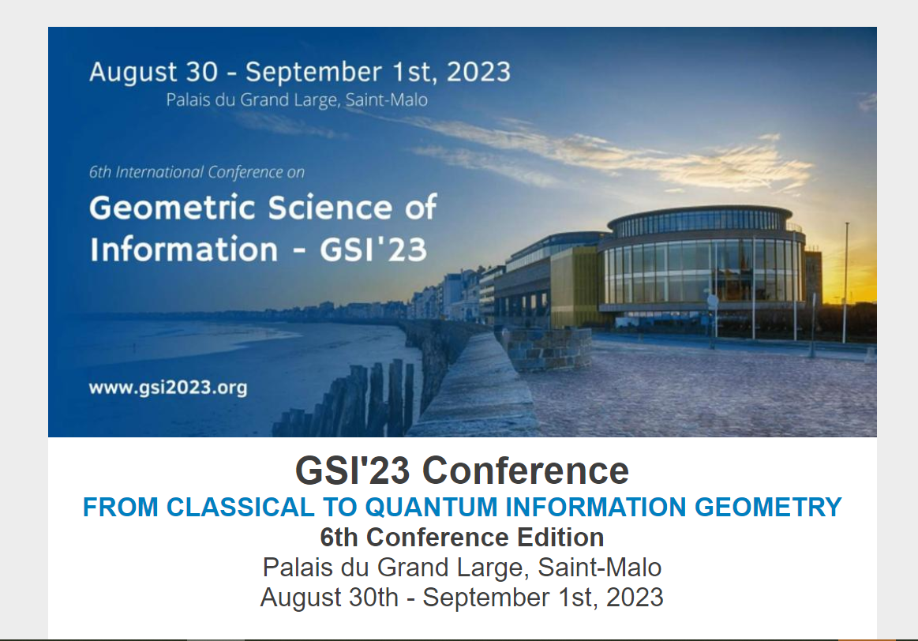
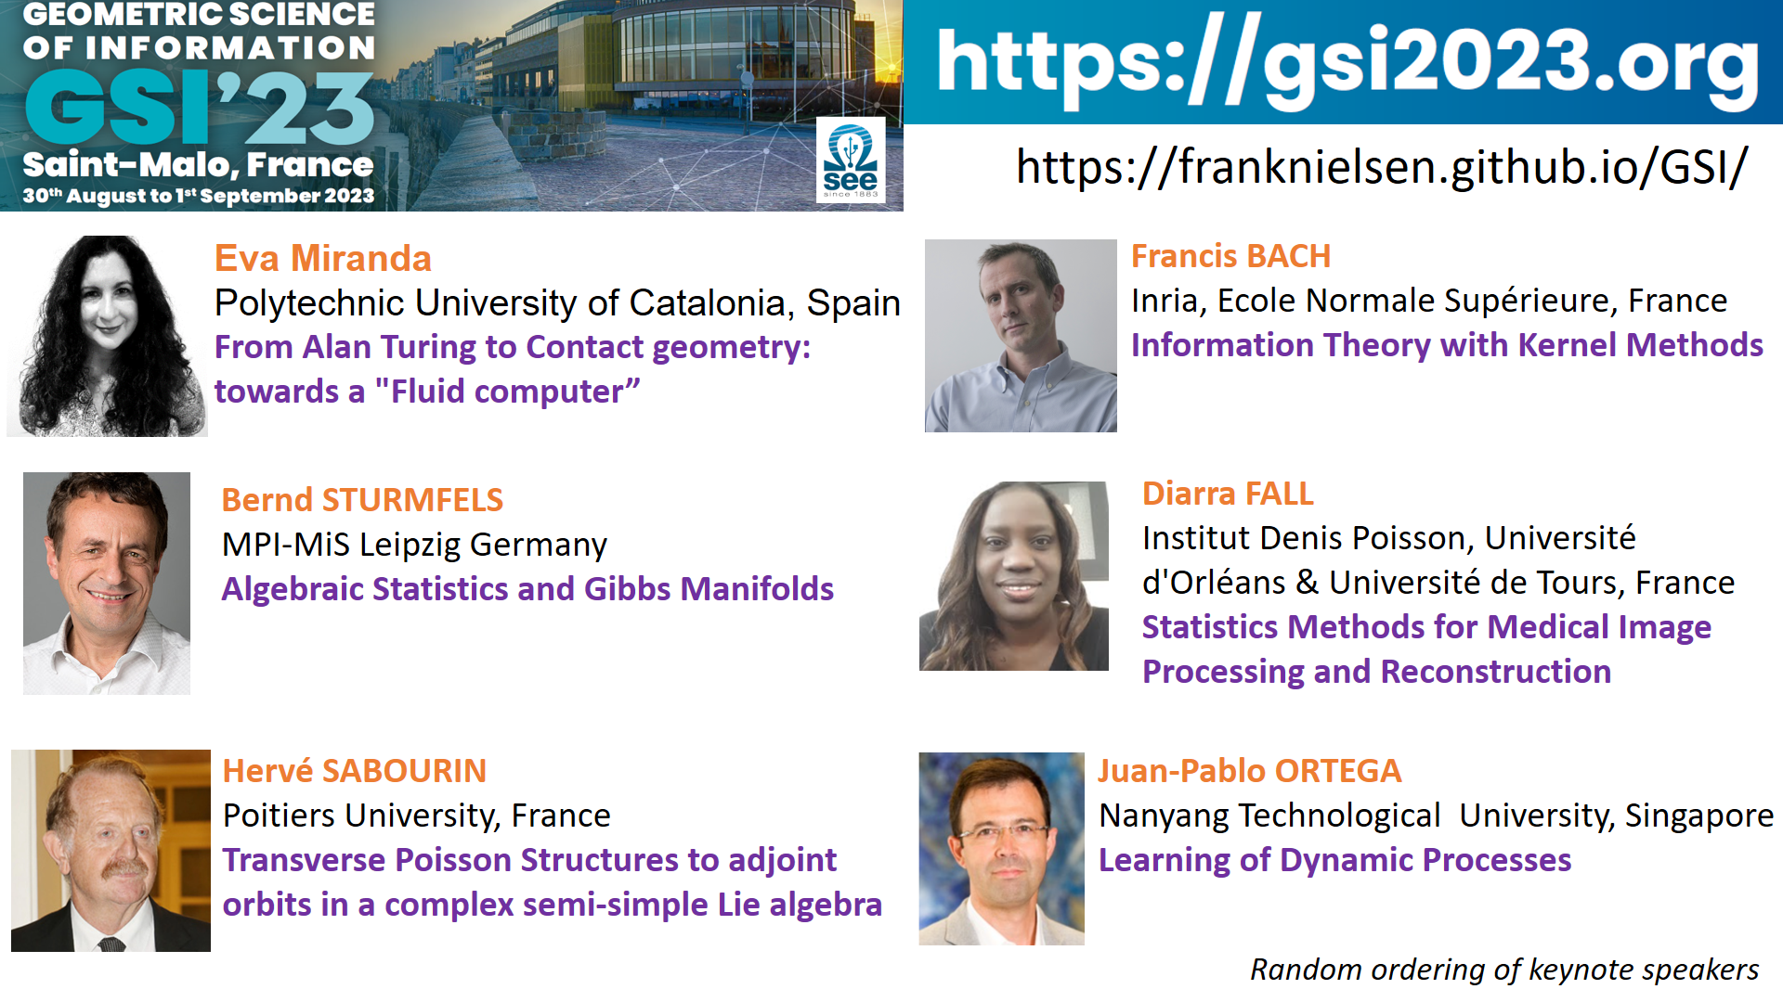
GSI: Biannual conference since 2013
https://conference-gsi.org/
Include 500+ GSI video talks:
franknielsen.github.io/GSI/

Slide 7
Information geometry: Geometry of dual structures

Slide 8
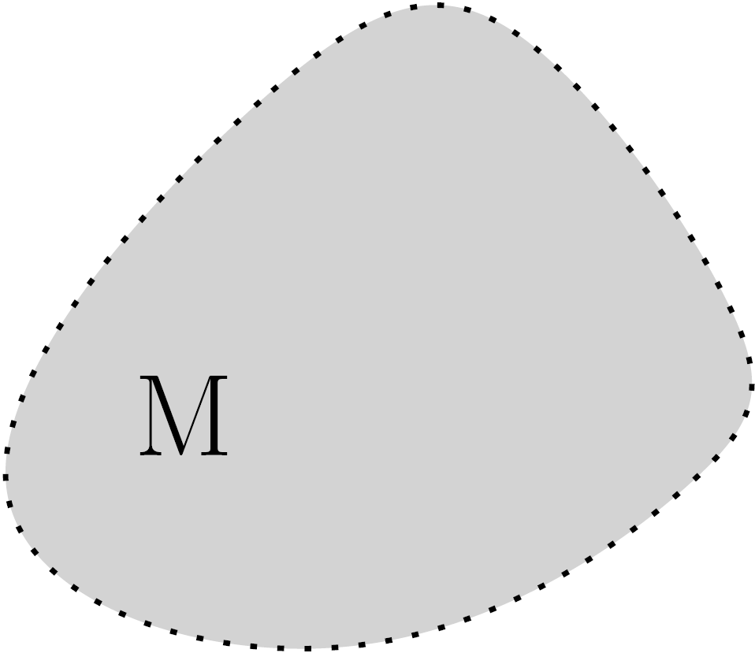
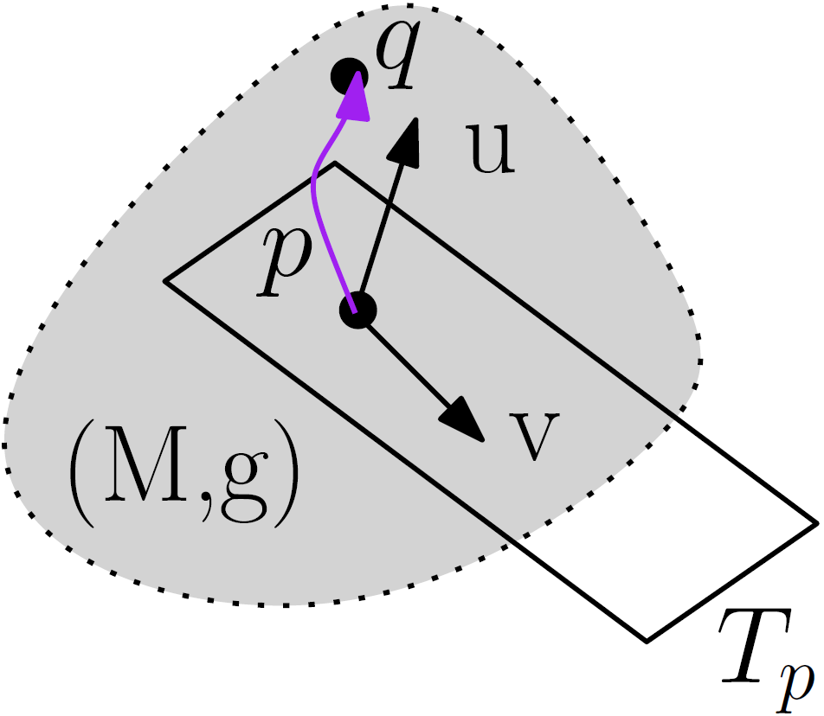
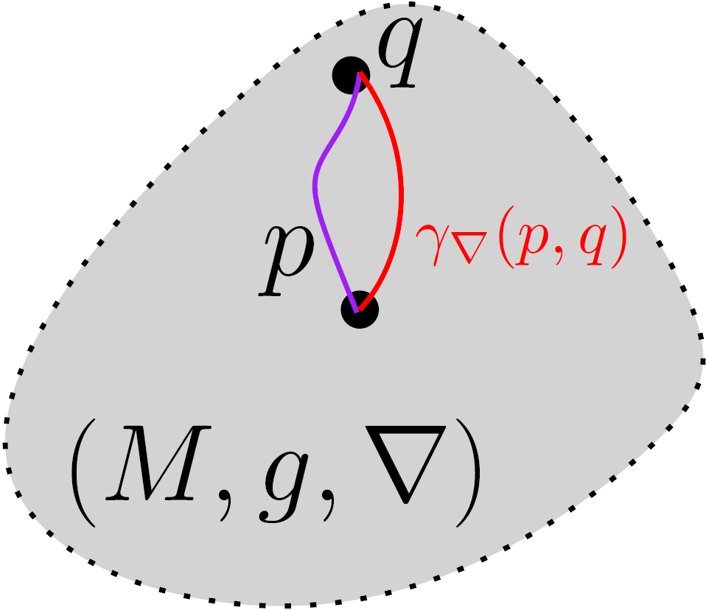
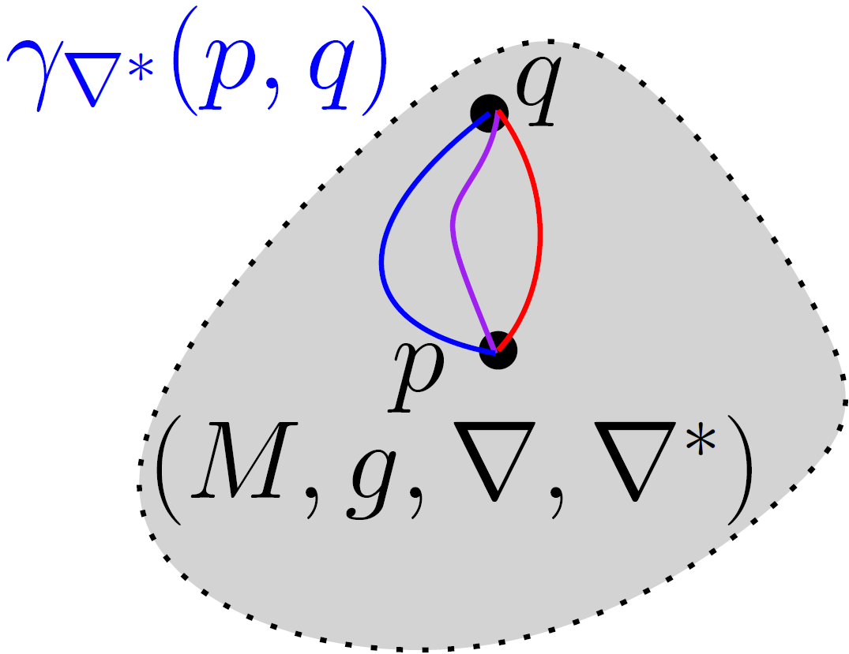

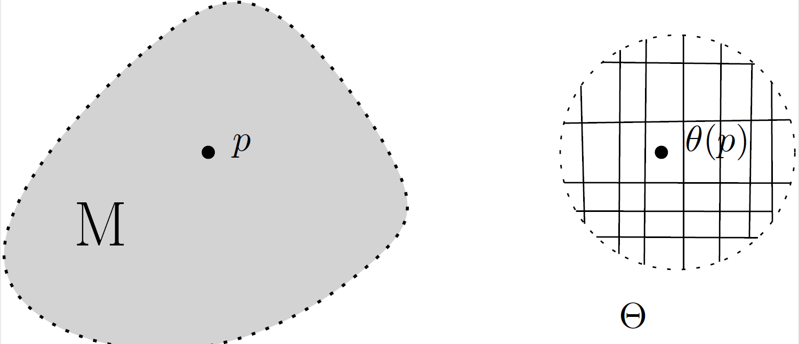
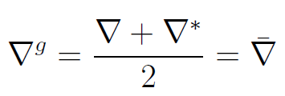
Build your own information geometry in three steps
Choose
Get dual IG
manifold
(M,g,∇,∇*)
① manifold M
② metric tensor g
③ affine connection ∇
du
dual
connection
Examples:
Gaussians
SPD cone
Probability simplex
Examples:
Fisher information metric
metric g^{D} from divergence
trace metric
Examples:
exponential connection
mixture connection
metric connection ∇^{g}
divergence connection ∇^{D}
α-connection
Concepts:
vector length
vector orthogonality
Riemannian geodesic
Riemannian distance
Levi-Civita connection ∇^{g}
chart
Concepts:
covariant derivative ∇
∇-geodesic
∇-parallel transport
curvature
Concepts:
local coordinates
locally Euclidean
Concepts:
dual connections coupled to metric g
dual parallel transport preserve metric g
Notes:
∇*=2∇^g- ∇

Slide 9
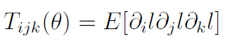
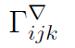
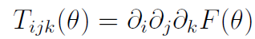
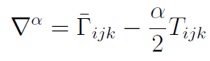
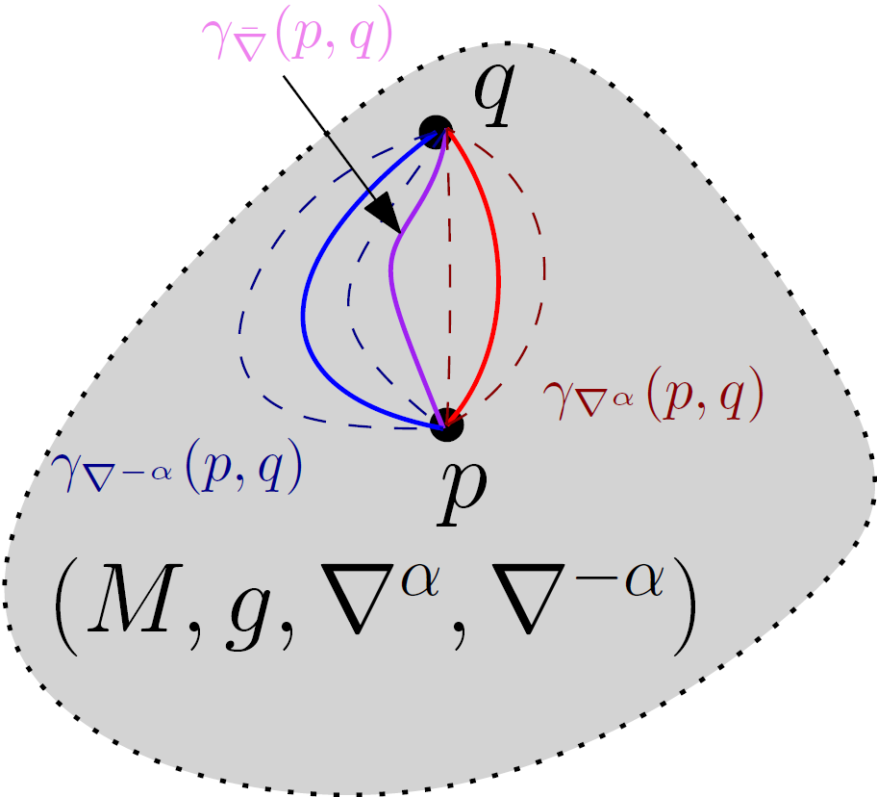
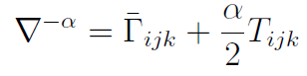
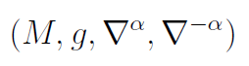
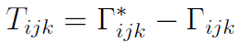
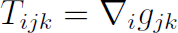
From dual information geometry to ±α-geometry, α∈ℝ
Choose
① manifold M
④ choose α
② metric tensor g
Examples:
Amari-Chentsov cubic tensor
Cubic tensor from divergence
③ affine connection ∇
by defining Christoffel symbols
Get dual IG manifold
(M,g,∇,∇*)
Get a family of dual connections/IG
(M,g,∇^{α},∇^{-α})
Cubic
tensor
±α-geometry
0-geometry
= Riemannian geometry
with geodesic distance
Notes:
$$
\Gamma_{ijk}^\nabla
$$
$$
T_{ijk}=\Gamma_{ijk}^*-\Gamma_{ijk}
$$
$$
T_{ijk}=\nabla_i g_{jk}
$$
$$
\nabla^\alpha=\bar{\Gamma}_{ijk}-\frac{\alpha}{2}T_{ijk}
$$
$$
\nabla^{-\alpha}=\bar{\Gamma}_{ijk}+\frac{\alpha}{2}T_{ijk}
$$
$$
(M,g,\nabla^\alpha,\nabla^{-\alpha})
$$
$$
T_{ijk}(\theta)=E[\partial_i l\partial_j l\partial_k l]
$$
$$
T_{ijk}(\theta)=\partial_i \partial_j\partial_k F(\theta)
$$

Slide 10
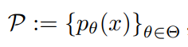
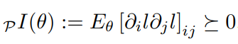
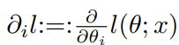
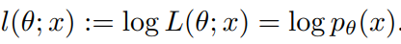
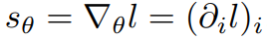
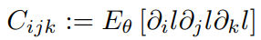
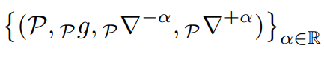
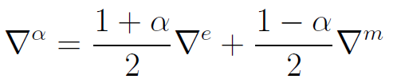
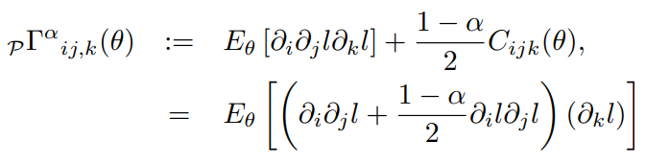
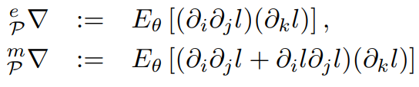
Information geometry from statistical models: (M,g^{F},∇^{-α},∇^{α})
Consider a parametric statistical/probability model:
Define metric tensor g from Fisher information = Fisher metric g^{F}
Model is regular if partial derivatives of l_{θ}(x) smooth and Fisher metric
is well-defined and positive-definite
Amari-Chentsov cubic tensor:
α-connections
Fisher-Rao geometry when α=0, get geodesic distance called Rao distance
Model Information Geometry (MIG)
covariance of the score
log-likelihood
α=1
exponential connection
α=-1
mixture connection
[Hotelling 1930]
[Rao 1945]
[Amari Nagaoka 1982]

Slide 11
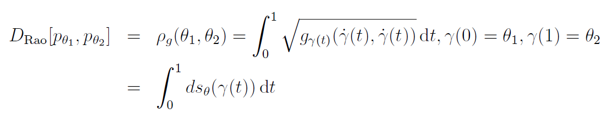
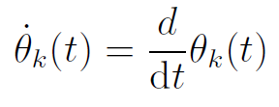
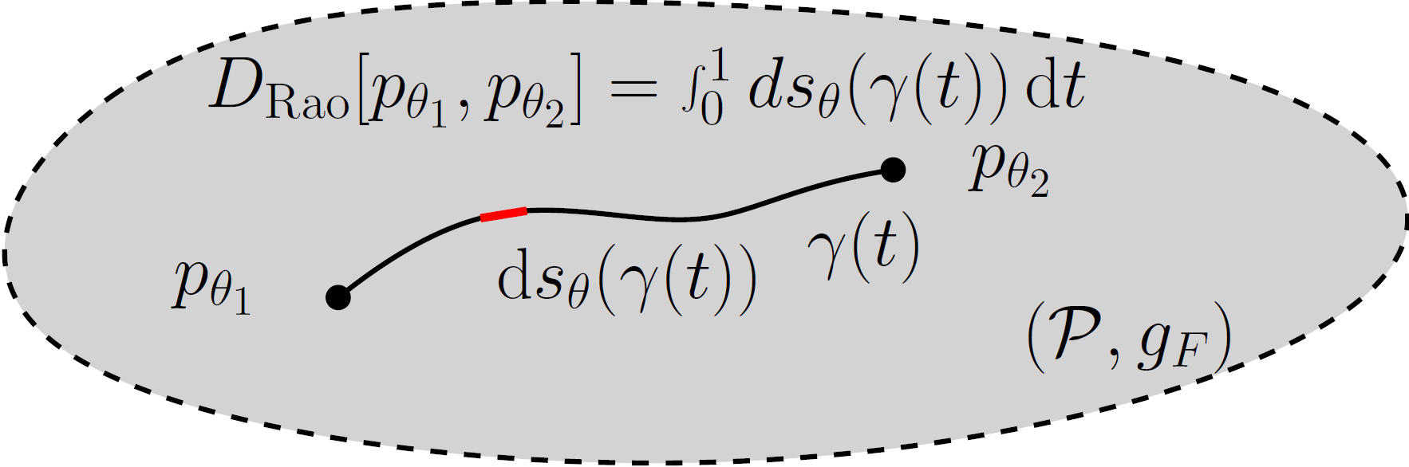
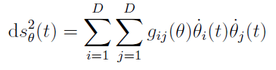
Rao distance on the Fisher-Rao manifold
Here, γ is the Riemannian geodesic
(or add a minimizer on all paths γ)
Length element
In practice:
Need to calculated geodesics which are curves locally minimizing the length linking two endpoints (equivalently minimize the energy of squared length elements)
Finding Fisher-Rao geodesics is a non-trivial tasks.
Good news 2023: closed-form geodesics with boundary conditions for MultiVariate Normals
Fisher-Rao and pullback Hilbert cone distances on the multivariate Gaussian manifold
with applications to simplification and quantization of mixtures, ICML ws TAGML 2023
Notes:
â à é è ç ê

Slide 12
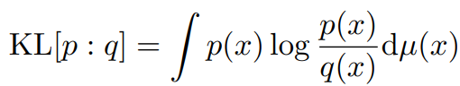
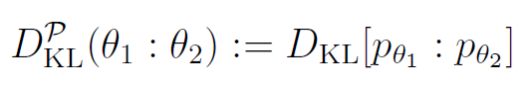
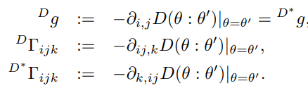
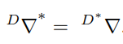
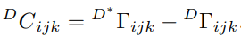
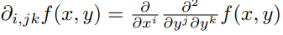
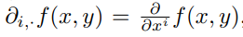
Information geometry from divergences: (M,g^{D},∇^{D},∇^{D*})
A statistical divergence like the Kullback-Leibler divergence is a smooth non-metric distance between probability measures
A statistical divergence between two densities of a statistical model is a parametric divergence (e.g., KLD between two normal distributions)
Construction of dual geometry from asymmetric parametric divergence D(θ₁:θ₂)
Dual divergence is D*(θ₁:θ₂)=D(θ₂:θ₁), reverse divergence
Divergence Information Geometry (DIG)
[Eguchi 1983]
Dual structure:
Cubic tensor:

Slide 13
Realizations of dual information geometry (stat mfd)
Realize (M,g,∇,∇) as a divergence information geometry (M,g^{D},∇^{D},∇^{D*}):
always exists a divergence D such that (M,g,∇,∇)=(M,g^{D},∇^{D},∇^{D*})
Matumoto, "Any statistical manifold has a contrast function—On the C3-functions taking the minimum at the diagonal of the product manifold." Hiroshima Math. J 23.2 (1993)
Realize (M,g,∇,∇) as a model information geometry (M,g^{F},∇^{-α},∇^{α})
always exists a statistical model M such that (M,g,∇,∇)=(M,_{P}g^{F},_{P}∇^{-α},_{P}∇^{α})
Lê, Hông Vân. "Statistical manifolds are statistical models." Journal of Geometry 84 (2006): 83-93.

Slide 14
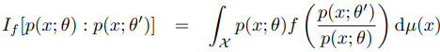
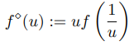
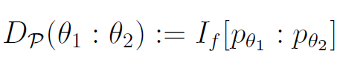
Equivalence: model α-IG ↔ divergence IG for f-divergences
Let P={p_{θ}} be a statistical model of probability distributions dominated by μ
Consider the f-divergence for a convex generator f(u) with f(1)=0, f'(1)=1, f''(1)=1 ← standard f-divergence (can always rescale g(u)=f(u)/f''(1))
The f-divergence between p_{θ1} and p_{θ2} is a parameter divergence D(θ₁:θ₂)
from which we can build the divergence information geometry (M,g^{D},∇^{D},∇^{D*})
Then model α-geometry for α=2 f'''(1)+3 coincide with divergence IG:
(M,g^{D},∇^{D},∇^{D*}) = (M,g^{F},∇^{-α},∇^{α}) for α=2 f'''(1)+3
metric tensor g^{D} and cubic tensor T^{D} coincides with Fisher metric g^{F} and Amari-Chentsov tensor T
Dual reverse f-divergence is a f-divergence for

Slide 15
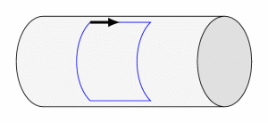
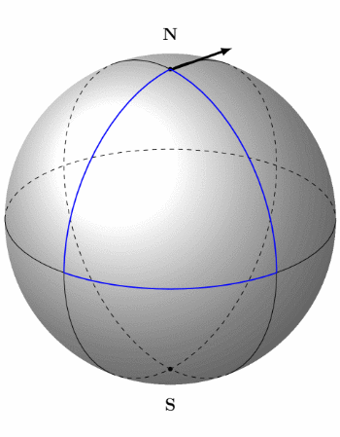
Curvature is associated to affine connection ∇
For Riemannian structure (M,g), use default Levi-Civita connection ∇=∇^{g}
Riemannian manifolds of dim d can always be embedded into Euclidean spaces E^{D} of dim D=O(d²)
Euclidean spaces have a natural affine connection ∇=∇^{E}
© CNRS
Cylinder is flat, 0 curvature:
Parallel transport along a loop of a vector preserves the orientation
Sphere has positive constant curvature:
Parallel transport along a loop exhibits
an angle defect related to curvature

Slide 16
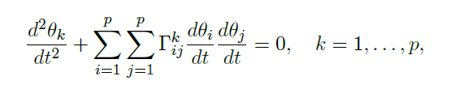
Dually flat spaces (M,g,∇,∇*)
Fundamental theorem of information geometry: If torsion-free affine connection ∇ is of constant curvature κ, then curvature of dual torsion-free affine connection ∇* is also constant κ
Corollary: if ∇ is flat (κ=0) then ∇* is flat: Dually flat space (M,g,∇,∇*)
A connection ∇ is flat if there exists a local coordinate system θ such that Γ(θ)=0
In ∇-affine coordinate system θ(.), ∇-geodesics are visualized as line segments
Γ(θ)=0
geodesics=line segments in θ

Slide 17
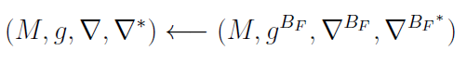
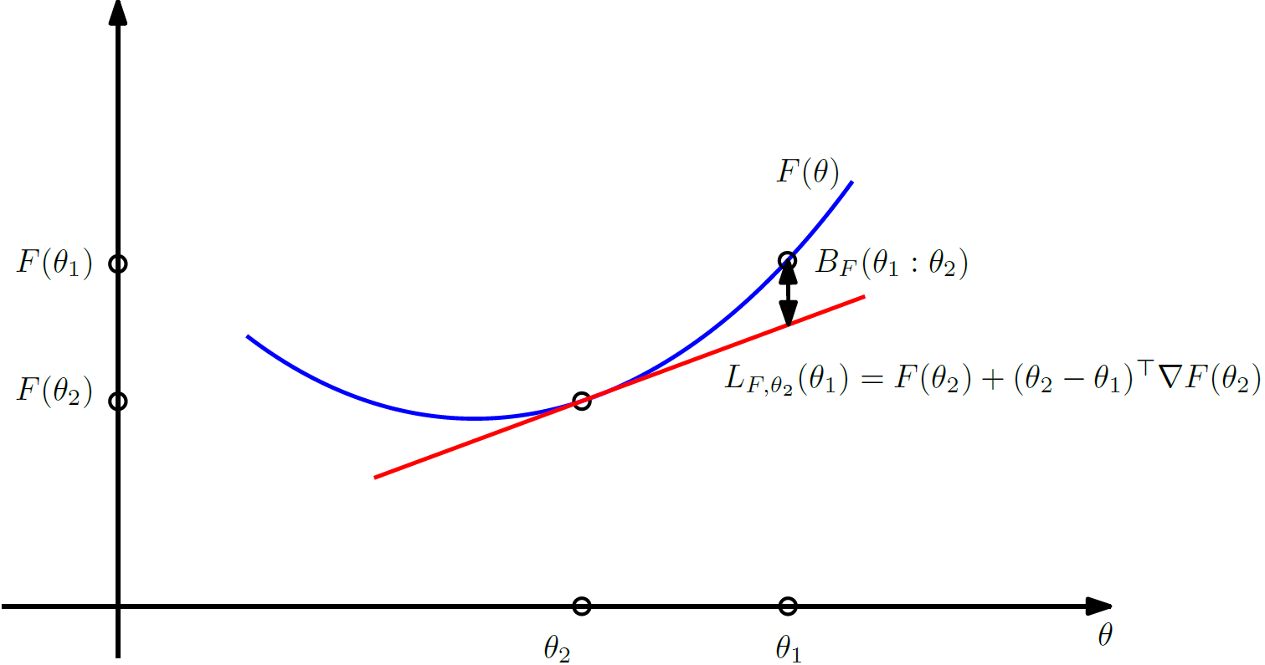
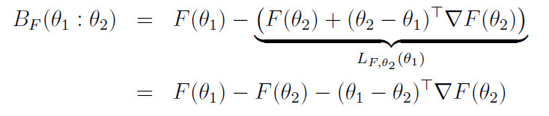
Canonical divergences of DFSs: Bregman divergences
Dually flat structure (M,g,∇,∇*) can be realized by a Bregman divergence
Let F(θ) be a strictly convex and differentiable function defined on an open convex domain ϴ
Bregman divergence interpreted as the vertical gap between
point (θ_{1,} F(θ₁)) and the linear approximation of F(θ) at θ₂ evaluated at θ₁ :
[Bregman 1967]
Notes:
â à é è ç ê

Slide 18
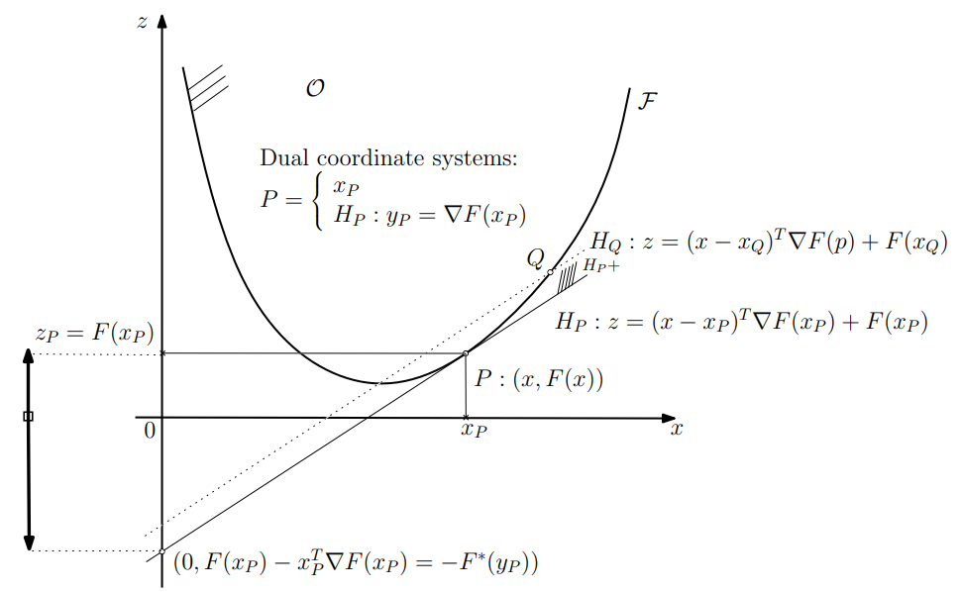
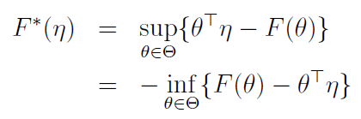
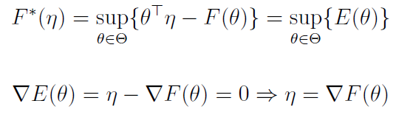

Legendre-Fenchel transformation: Slope transformation
Consider a Bregman generator of Legendre-type (proper, lower semi-continuous). Then its convex conjugate obtained from the Legendre-Fenchel transformation is a Bregman generator of Legendre type.
Analogy of the Halfspace/Vertex representation of the epigraph of F
Fenchel-Moreau’s biconjugation theorem for F of Legendre-type:
Concave programming:
Epigraph
Slope
[Touchette 2005] Legendre-Fenchel transforms in a nutshell
[2010] Legendre transformation and information geometry
Notes:
proper, lower semi-continuous, and convex function,

Slide 19







Mixed coordinates and the Legendre-Fenchel divergence
Dual Legendre-type functions
Convex conjugate of F is
Fenchel-Young inequality :
with equality holding if and only if
Fenchel-Young divergence make use of the mixed coordinate systems θ et η to express a Bregman divergence as :
Gradient
are inverse
of each other
Notes:
â à é è ç ê

Slide 20







Generalized Pythagoras theorem in dually flat spaces
In general, Identity of Bregman divergence with three parameters = law of cosines
Generalized Pythagoras’ theorem
Pythagoras’ theorem in
the Euclidian geometry
(Self-dual)
orthogonality condition:
Notes:
â à é è ç ê ù û ï

Slide 21



Slide 22



Dually flat space from a smooth strictly convex function F(θ)
A smooth strictly convex function F(θ) define a Bregman divergence and hence a dually flat space via Eguchi's divergence-based IG
Examples of DFSs induced by convex functions:
Domain
dual Bregman divergences

Slide 23
Dual geometry of information geometry: Information geometry as a tool to geometrize duality
A pair of (torsion-free) affine connections (∇,∇*) with (∇*)*=∇
Examples:
Geometrize
Objects: divergences D
duality = reverse divergence D*
(D*)*=D
(∇^{D},∇^{D*})
Geometrize
Objects: Legendre type functions F
duality = convex conjugate F*
(F*)*=F
(∇^{F},∇^{F*})
Geometrize
Type: strictly monotone functions
duality f* = reciprocal f⁻¹
(f*)*=f
(∇^{f},∇^{f*})
Geometric terminology:
dual contrast functions
dual potential functions
dual f-representations
(±α-representations)

Slide 24
Quasi-arithmetic centers,
quasi-arithmetic mixtures, and the
Jensen-Shannon ∇-divergences
arXiv:2301.10980

Slide 25
Outline and contributions
Goals:
Generalize scalar quasi-arithmetic means to multivariate cases
Show that the dually flat spaces of information geometry yields a natural framework for defining and studying this generalization

Slide 26

Weighted quasi-arithmetic means (QAMs)
Standard (n-1)-dimensional simplex:
QAMs enjoy the in-betweenness property:
[Kolmogorov 1930] [Nagumo 1930] [De Finetti 1931]

Slide 27


Quasi-arithmetic means (QAMs)
Classes of generators [f]=[g] with f ≡ g yieldings the same QAM:
So let us fix wlog. strictly increasing and differentiable f since we can always either consider either f or -f (i.e., λ=-1, c=0).
QAMs include p-power means for the smooth family of generators f_{p}(t):
Pythagoras means: Harmonic (p=-1), Geometric (p=0), Arithmetic (p=1)
Homogeneous QAMs s are exactly p-power means

Slide 28

Quasi-Arithmetic Centers (QACs) = Multivariate QAMs:
Univariate QAMs:
Two problems we face when going from univariate to multivariate cases:
Define the proper notion of "multivariate increasing" function F and its equivalent class of functions
In general, the implicit function theorem only proves locally and inverse function F⁻¹ of F: R^{d} → R^{d} provided its Jacobian matrix is not singular
Information geometry provides the right framework to generalize QAMs to
quasi-arithmetic centers (QACs) and study their properties.
Consider the dually flat spaces of information geometry

Slide 29





Legendre-type functions
Legendre-Fenchel transformation of a convex function:
Problem: Domain H of η may not be convex...
counterexample with
[Rockafeller 1967]
To by pass this problem:
Convex conjugate of a Legendre-type function (ϴ,F(θ)) is of Legendre-type:
Given by the Legendre function:
Gradient map ∇F is globally invertible: ∇F⁻¹

Slide 30



Comonotone functions in inner product spaces
Comonotone functions:
(i.e., comonotone = monotone with respect to the identity function)
Proof using symmetrization of Bregman divergences = Jeffreys-Bregman divergence:
because Bregman divergences(and sums thereof) are always non-negative
Remark: Generalization of monotonicity because when d=1, f(x) is strictly monotone iff
f(x₁)-f(x₂) is of same sign of x₁-x₂ that is, (f(x₁)-f(x₂)) (x₁-x₂)>0

Slide 31



Quasi-arithmetic centers: Definition generalizing QAMs
This definition generalizes univariate quasi-arithmetic means :
Let
Then we have

Slide 32








An illustrating example: The matrix harmonic mean
Consider the real-value minus logdet function
Domain F: the cone of symmetric positive-definite matrices
Inner product:
We have:
←Legendre-type function
←Legendre-type function
The quasi-arithmetic center with respect to F:
The quasi-arithmetic center with respect to F*:
Generalize univariate harmonic mean with F(x)= log x, f(x)=F'(x)=1/x:
A Legendre-type function F gives rise to a pair of dual quasi-arithmetic centers
M_{∇F} and M_{∇F*} : dual operators

Slide 33


Dually flat structures of information geometry
A Legendre-type Bregman generator F() induces a dually flat space structure:
A point P can be either parameterized by θ-coordinate and dual η-coordinate
[AMS 2022]
Notes:
[Nielsen 2022]

Slide 34

Quasi-arithmetic barycenters and dual geodesics
The dual geodesics induced by the dual flat connections can be expressed using dual weighted quasi-arithmetic centers:
←dual QAC M_{∇F*}
←primal QAC M_{∇F}

Slide 35





n-Variable Quasi-arithmetic centers as centroids in dually flat spaces
Consider
(canonical divergence = Bregman divergence)
Right-sided centroid:
Left-sided centroid:
Reference duality
←primal QAC
←dual QAC
Notice that when n=2, weighted dual
quasi-arithmetic barycenters
define the dual geodesics

Slide 36






Invariance/equivariance of quasi-arithmetic centers
Information geometry is well-suited to study the properties of QACs:
A dually flat space (DFS) can be realized by a class of Bregman generators:
Affine Legendre invariance of dually flat spaces:
By adding an affine term...
By an affine change of coordinate...
Invariance of quasi-arithmetic center:
Same DFS with
Same DFS with
such that
Equivariance of quasi-arithmetic center:
Same canonical divergence of the DFS
(= constrast function on the diagonal of the product manifold)

Slide 37





Canonical divergence versus Legendre-Fenchel/Bregman divergences
Canonical divergence induced by dual flat connections is between points
dual Bregman divergences B_{F} and B_{F*} between dual coordinates
Legendre-Fenchel divergence Y_{F} between mixed coordinates
Notes:
\def\DFS{\mathrm{DFS}}
\begin{document}
\begin{eqnarray*}
(M,g,\nabla,\nabla^*) &\leftarrow& \DFS([\Theta,F(\theta),H,F^*(\eta)])\\
&\leftarrow& \DFS([\bar\Theta,\bar F(\bar\theta),\bar H,\bar F^*(\bar\eta)])
\end{eqnarray*}
$$
F(\theta)+F^*(\eta)-\inner{\theta}{\eta}=0
$$
$$
\eta=\nabla F(\theta)
$$
\begin{eqnarray*}
B_F(\theta_1:\theta_2) &:=& F(\theta_1) - \underbrace{F(\theta_2)}_{=\inner{\theta_2}{\eta_2}-F^*(\eta_2)} - \inner{\theta_1-\theta_2}{\nabla F(\eta_2)}\\
&=& F(\theta_1)+F^*(\eta_2) -\inner{\theta_1}{\eta_2} =: Y_F(\theta_1:\eta_2)
\end{eqnarray*}
\begin{eqnarray*}
D_{\nabla,\nabla^*}(P_1:P_2) &=& B_F(\theta_1:\theta_2) = B_{F^*}(\eta_1,\eta_2)= Y_F(\theta_1:\eta_2)= Y_{F^*}(\eta_2:\theta_1)\\
&=& B_{\bar F}(\overline{\theta_1}:\overline{\theta_2}) = B_{\bar{F}^*}(\overline{\eta_1},\overline{\eta_2})= Y_F(\overline{\theta_1}:
\overline{\eta_2})= Y_{F^*}(\overline{\eta_2}:\overline{\theta_1})
\end{eqnarray*}
\end{document}

Slide 38



Affine Legendre invariance of dually flat spaces plus setting the unit scale of divergences
Affine Legendre invariance:
Set the unit scale of canonical divergence (DFS differ here, rescaled):
(does not change the quasi-arithmetic center)
amount to scale the potential function λF(θ) vs F(θ)

Slide 39



Illustrating example: Mahalanobis divergence
Mahalanobis divergence = squared Mahalanobis metric distance
The dual QACs induced by the dual Mahalanobis generators F and F* coincide to weighted arithmetic mean M_{id}:
fails triangle inequality
of metric distances
Primal potential function:
Dual potential function:

Slide 40



Quasi-arithmetic mixtures (QAMixs), and α-mixtures
Centroid of n densities with respect to the α-divergences yields a QAMix:
D_{α} denotes the α-divergences:
α-families of probability distributions
[Amari 2007]
[arXiv:2209.07481]

Slide 41


k=2 QAMixs and the ∇-Jensen-Shannon divergence
Jensen-Shannon divergence is bounded symmetrization of KL divergence:
Interpret arithmetic mixture as the midpoint of a mixture geodesic (wrt to the flat non-parametric mixture connection ∇^{m} in information geometry).
Generalize Jensen-Shannon divergence with arbitrary ∇-connections:
≤ log(2)

Slide 42



Inductive Means: Geodesics/quasi-arithmetic centers
Gauss and Lagrange independently studied the following convergence of pairs of iterations:
In general, choosing two strict means M and M' with interness property will converge but difficult to analytically express the common limits of iterations
When M=Arithmetic and M'=Harmonic, the arithmetic-harmonic mean AHM yields the geometric mean:
and proves quadratic convergence to
the arithmetic-geometric mean AGM
where K is complete elliptic integral of the first kind
AGM also used to approximate ellipse perimeter and 𝜋

Slide 43





Inductive matrix arithmetic-harmonic mean
Consider the cone of symmetric positive-definite matrices (SPD cone), and extend the AHM to SPD matrices:
Then the sequences converge quadratically to the matrix geometric mean:
←arithmetic mean
←harmonic mean
which is also the Riemannian center of mass with respect to the trace metric:
Riemannian distance
[Nakamura 2001, Atteia-Raissouli 2001 ]
Notes:
Atteia-Raissouli

Slide 44








Geometric interpretation of the AHM matrix mean
(SPD, g^{G}, ∇^{A}, ∇^{H}) is a dually flat space, ∇^{G} is Levi-Civita connection
Dually flat space (SPD, g^{G}, ∇^{A}, ∇^{H})
in information geometry defines
quasi-arithmetic centers as geodesic midpoints
Primal geodesic midpoint is the arithmetic center wrt Euclidean metric
Dual geodesic midpoint = harmonic center wrt an isometric Eucl. metric
Levi-Civita geodesic midpoint is geometric Karcher mean (not QAC)
A balanced metric
[Nakamura 2001, Thanwerdas & Pennec 2019]

Slide 45
Revisiting Chernoff information with Likelihood Ratio Exponential Families
Entropy 2022
[2207.03745]
Notes:
20 minutes : 15 minutes + question

Slide 46




Chernoff information: Definition & Background A symmetric statistical divergence
Originally introduced by Chernoff (1952) to upper bound the probability of error (Bayes' error) in statistical hypothesis testing.
skewed Bhattacharyya coefficient ρ_{α} (similarity coefficient)
Definition:
Herman Chernoff
(1923-)
(via Hölder inequality)
Synonyms: Chernoff divergence, Chernoff information number, Chernoff index...
Found later many applications in information fusion, radar target detection,
generative adversarial networks (GANs), etc. due to its empirical robustness
Notes:
https://en.wikipedia.org/wiki/Herman_Chernoff

Slide 47




Chernoff information = Maximally skewed Bhattacharyya distance
skewed Bhattacharyya distance (a Ali-Silvey f-divergence):
Chernoff information:
scaled skewed Bhattacharyya distance = Rényi divergence (extends KLD)
Optimal values of α is called ``Chernoff (error) exponent'' (due to its seminal use in statistical hypothesis testing)

Slide 48


Rationale for CI: Statistical hypothesis testing
Statistical mixture:
m(x)=0.5*N(0,1)+0.5*N(5,2)
Hypothesis task:
Decides whether x emanates
from p1 or p2?
Classification rule:
Maximum a posteriori (MAP)
if p1(x)>p2(x) classify as p1
else classify as p2
Error at x: min(p1(x),p2(x))
Histogram intersection similarity:
x classified as p1
x classified as p2
Notes:
/*m(x)=0.5*N(0,1)+0.5*N(5,2)*/normal(x,mu,sigma) := (1.0/(sqrt(2*%pi)*sigma))*exp(-((x-mu)**2)/(2*sigma**2) );p1(x):=0.5*normal(x,0,1);p2(x):=0.5*normal(x,5,2);m(x):=p1(x)+p2(x);plot2d([p1(x),p2(x),m(x)],[x,-3,15], [xlabel,"x"], [ylabel,"Probability"],[legend, "p1", "p2", "m"],[style, [lines,5,1],[lines,5,2],[lines,5,5]]);

Slide 49








Rewriting and bounding the probability of error
Use rewriting trick min(a,b)=(a+b)/2 + |b-a|/2 for a,b>0
express the probability of error using the total variation distance:
Use a generic (weighted) mean which necessarily falls inbetween its extrema (e.g., geometric mean):
geometric weighted mean
"Generalized Bhattacharyya and Chernoff upper bounds on Bayes error using quasi-arithmetic means." Pattern Recognition Letters 42 (2014): 25-34.

Slide 50







Likelihood ratio exponential families (LREFs)
Geometric mixture (Bhattacharyya /exponential arc )
between two densities p, q of Lebesgue Banach space L₁(μ)
Set of geometric mixtures:
with normalization factor:
geometric mixture interpreted as a 1D exponential family: LREF
Sufficient statistics: log likelihood ratio
Natural parameter space:
k(x)=log q(x)
-

Slide 51



LREFs: EF cumulant function is always analytic C^{ω}
Cumulant function of EF is strictly convex
(and smooth for regular EFs)
Cumulant function is neg-Bhattacharyya distance:
⇒ Bhattacharyya. distance is strictly concave
Theorem:
Chernoff exponent exists and is unique
p=N(0,1)
q=N(1,2)

Slide 52



Geometric mixtures and LREFs: Regular EFs
Natural parameter space:
always contains (0,1) since
What happens at extremities and when extrapolating (depends on support):
Exponential family is said regular when the natural parameter space Θ is open (e.g., normal family, Dirichlet family, Wishart family, etc.)
Definition:
regular EF

Slide 53




When (0,1) is strictly included in regular LREFs
KLD between two densities of a regular EF = reverse Bregman divergence:
steep ⇒
regular EF ⇒ steep EF

Slide 54

Venn diagram: Regular & steepness of (LR)EFs
Steepness implies duality between natural θ and moment 𝜂 parameters

Slide 55


PROOF
Remember KLD=Bregman divergence between densities of a regular (LR)EF
Scalar Bregman divergence
idem for

Slide 56










Chernoff information (for densities of a LREF)
Proposition:
PROOF
First, skew Bhattacharyya distance = skew Jensen divergence
Thus we have:
At the optimal value α*, we have
①
②
③

Slide 57



Jensen-Chernoff divergence
non-parametric arguments
scalar parametric arguments
In general, define Jensen-Chernoff divergence
Notes:
\begin{eqnarray*}
D_C[p,q] &=& B_{F_{pq}}(1:\alpha^*)=B_{F_{pq}}(0:\alpha^*)\\
&=& J_{F_{pq}}(0:1)
\end{eqnarray*}

Slide 58





Geometric interpretation for densities p, q on L₁(μ)
Left KL Voronoi bisector:
Geodesic = exponential arc:
2209.07481
Chernoff point:

Slide 59





Special case of LREF: p,q are densities of a same EF!
EF includes Gaussians, Beta, Dirichlet, Wishart, etc.

Slide 60


Bregman manifold (= global Hessian manifold)

Slide 61

Interpreting the uniqueness of Chernoff exponent from pure information geometry point of view
Since the Chernoff point is unique, we can also interpret more generally this property in a general dually flat space (not necessarily an EF) as known as a Bregman manifold
"On geodesic triangles with right angles in a dually flat space."
Progress in Information Geometry. Springer, 2021. 153-190.

Slide 62
Duo Bregman pseudo-divergences: Applications to the KL divergence between truncated densities

Slide 63


Slide 64


Slide 65


Slide 66


Slide 67
Paper references
"An elementary introduction to information geometry." Entropy 22.10 (2020): 1100.
"Beyond scalar quasi-arithmetic means: Quasi-arithmetic averages and quasi-arithmetic mixtures in information geometry." arXiv preprint arXiv:2301.10980 (2023).
"Revisiting Chernoff Information with Likelihood Ratio Exponential Families." Entropy 24.10 (2022): 1400.
"Statistical divergences between densities of truncated exponential families with nested supports: Duo Bregman and duo Jensen divergences." Entropy 24.3 (2022): 421.

